Slide 1

From 0 to Cassandra on AWS in 30 days
Tsunami alerting with Cassandra
Andrei Arion - Geoffrey Bérard - Charles Herriau
@BeastieFurets
Notes:
GBE

Slide 2
1 | Context
2 | The project, step by step
3 | Feedbacks
4 | Conclusion
Notes:
GBE

Slide 3
Notes:
CHE

Slide 4

LesFurets.com
1st independant insurance aggregator
A unique place to compare and buy hundreds of insurance products
Key figures:
2 500 000 quotes/year
31% market share on car comparison (january 2015)
more than 50 insurers
Notes:
CHE
launched in september 2012
Recent launched services: mobile phones plan and loan comparison
Compare prices, assurance, services: car, bike, home, health and credit TODO pictos

Slide 5

LesFurets.com
Notes:
GBE

Slide 6







@BeastieFurets
4 Teams | 25 Engineers | Lean Kanban | Daily delivery
Notes:
GBE

Slide 7








LesFurets.com
Notes:
CHE
We are hiring

Slide 8
Bigdata@Telcom ParisTech
Notes:
AAR

Slide 9

Context
Master Level course
Big Data Analysis and Management
Non relational Databases
30 hours
Lectures: 25 %
Hand’s on: 75 %
http://www.telecom-paristech.fr/formation-continue/masteres-specialises/big-data.html
Notes:
AAR:
Un master specialise qui propose aux etudiants venant d’autres formations ou a des professionnels a se former dans ce nouveau domain - Bigdata.
Il y a 3 volets de cette formation:
un volet informatique lie a l’administration des donnees .
Un volet machine learning, un volet matematique destine a concevoir de l'algorithme avec un but predictif, pour donner de la valeur aux donnees
volet juridique/economique: ou est la valeur dans bigdata, dans quel ecosysteme cela s’inscrit
Recemment diplome M2 completer ca formation d’une maniere plus operationnelle, ou etre en entreprise
Former des data scientist, des gens avec une panoplie de connaissance generale: informatique, machine learning completee avec des aspects juridiques/economiques
Mastere propose par ParisTech en colaboration avec des entreprises. Tres oriente pratique, retour d’experience des entreprises proposees aux etudiants M2 ou a des gens qui sont dans l’entreprise et il vont faire une formation complementaire.
Presentation du mastere par son createur: https://youtu.be/k9yKpM3qw_w

Slide 10



Context
30 students:
various backgrounds: students and professionals
various skill levels
various expertise area: devops, data engineer, marketing
SQL and Hadoop exposure
Main topics:
http://www.telecom-paristech.fr/formation-continue/masteres-specialises/big-data.html
Notes:
AAR
Retour d’experience sur notre architecture data : mysql replication active/passive + DRBD et la problematique de passage a l’echele d’une base de donnees relationnelles.
On a presente des systemes de BDD
1-2 sceances par technologie + projet d’un mois

Slide 11
Project goals
Choose the right technology
Implement from scratch a full stack solution
Optimize data model for a particular use case
Deploy on cloud
Discuss tradeoffs
One month to deliver
http://www.telecom-paristech.fr/formation-continue/masteres-specialises/big-data.html
Notes:
AAR

Slide 12
The project,
Step by step
Notes:
GBE

Slide 13

Let’s all become students
Notes:
GBE

Slide 14


Labor day
1
Notes:
GBE

Slide 15
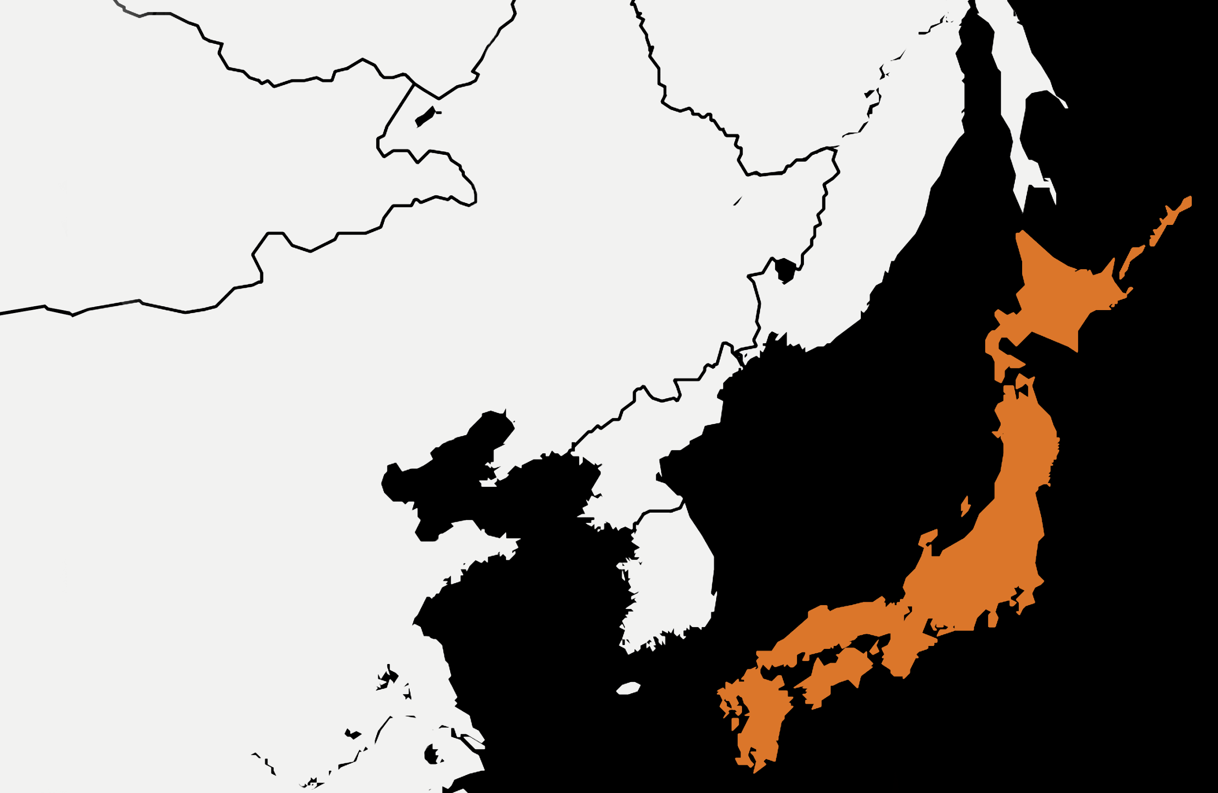
Discovering the subject
Notes:
GBE

Slide 16
Discovering the subject
An earthquake occurs in the Sea of Japan. A tsunami is likely to hit the coast.
Notify all the population within a 500km range as soon as possible.
2
Constraints:
Team work (3 members)
Choose a technology seen in the module
Deploy on AWS (300€ budget)
The closest data center is lost
Pre-load the data
Notes:
GBE

Slide 17
Discovering Data
Notes:
CHE

Slide 18
How to get the data ?
Generated logs from telecom providers
One month of position tracking
1 Mb, 1 Gb, 10 Gb, 100 Gb files
Available on Amazon S3
3
Notes:
CHE

Slide 19
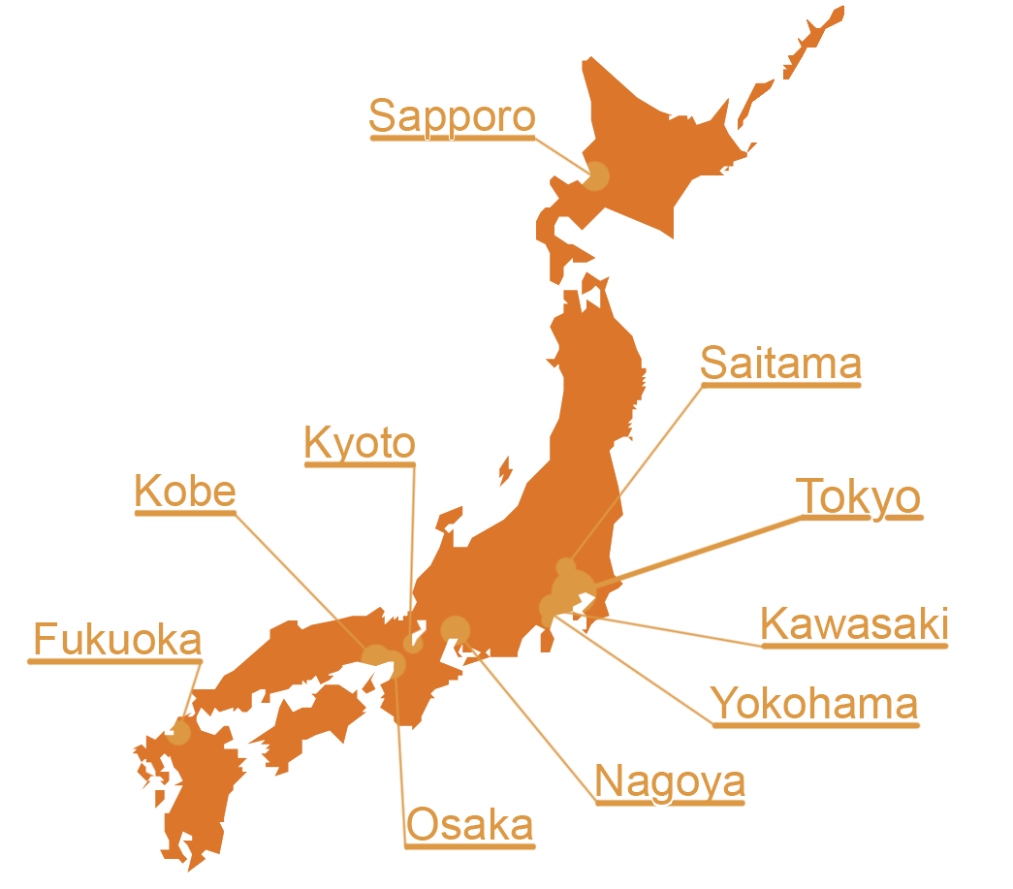
Data distribution
10 biggest cities
100 network cells/city
1.000.000 different phone numbers
4
Notes:
CHE
TODO: Check number of entry per hour/cell/phone

Slide 20
Data format
2015-01-04 17:10:52,834;Osa_61;34.232793;135.906451;829924
4
Timestamp
Cell ID
Coordinates
Phone Number
Notes:
CHE
Data clean-up: date format

Slide 21
Data distribution
Full dataset (100 GB):
240 000 logs per hour / city
~ 2 000 000 000 rows
5
Notes:
CHE
Real Synthetic dataset
ideal for data distribution (no hotspot)
high compression factor (~ 4x)

Slide 22
Data distribution
2015-01-04 17:10:52,834;Osa_61;34.232793;135.906451;829924
2015-01-04 17:10:52,928;Yok_85;35.494120;139.424249;121737
2015-01-04 17:10:52,423;Tok_14;35.683104;139.755020;731737
2015-01-04 17:10:53,923;Osa_61;34.232793;135.906451;861343
2015-01-04 17:10:53,153;Kyo_06;34.980933;135.777283;431737
...
2015-01-04 17:10:55,928;Yok_99;35.030989;140.126021;829924
5
Notes:
CHE
TODO: Check number of entry per hour/cell/phone

Slide 23

Data distribution
5
Notes:
CHE
TODO: Check number of entry per hour/cell/phone

Slide 24
Choosing the stack
Notes:
AAR

Slide 25
Storage Technology short list
6
Efficient for logs
Fault Tolerance
Geolocation
Easy transform logs into documents
Notes:
AAR
TLDR: geo positions are cell station positions
But du slide: parmi les Technos presentées ceux qui ont plus de sens.
Pourquoi on a laisser tomber postgres: vu que c’est difficile a passer a l’echelle, elasticsearch => fulltext

Slide 26
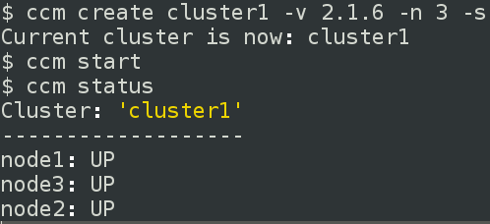
Install a local Cassandra cluster
7
Notes:
AAR

Slide 27
Data Modeling
Notes:
CHE

Slide 28
Naive model
CREATE TABLE phones1 (
cell text,
instant timestamp,
phoneNumber text,
PRIMARY KEY (cell, instant)
);
9
Osa_19 | 2015-05-19 15:25:57,369 | 2015-05-21 15:00:57,551
 | 456859 | 012564
Notes:
CHE
CONS : - écrase le numéro de téléphone pour un même instant
Que faire si on dépasse le 2 milliards de colonnes
PROS : - facile à insérer

Slide 29
Avoid overwrites
CREATE TABLE phones2 (
cell text,
instant timestamp,
phoneNumbers Set<text>,
PRIMARY KEY (cell, instant)
);
9
Osa_19 | 2015-05-19 15:25:57,369 | 2015-05-21 15:00:57,551
 | 456859, 659842 | 012564
Notes:
CHE
PROS : - code antenne dans la PK, on peut requêter dessus
pas de risque d’écraser les numéros de téléphone pour un même moment sur une même cellule
CONS : - On ne peut pas trop en mettre dans un Set
Lire tout l’historique (10Go) alors qu’une seule tranche horaire nous intéresse

Slide 30
Compound partition key
CREATE TABLE phones3 (
cell text,
instant timestamp,
phoneNumber text,
PRIMARY KEY ((cell, instant), phoneNumber)
);
10
Osa_19 : 2015-05-19 15:25:57,369 | 456859 | 659842
 | - | -
Notes:
CHE
PROS : - Plutôt que peu de ligne avec beaucoup de colonnes, on a plus de ligne à moins de colonnes.
on sélectionne directement l’info dont on a besoin, pas de chargement inutile
CONS: Inutilisable à cause du timestamp dans la clé, pas de pas range query sur la clé

Slide 31
Hourly bucketing
CREATE TABLE phones4 (
cell text,
instant timestamp,
phoneNumber text,
PRIMARY KEY ((cell, instant), phoneNumber)
);
10
Osa_19 : 2015-05-19 15:00 | 456859 | 659842
 | - | -
Notes:
CHE
PROS : - Plutôt que peu de ligne avec beaucoup de colonnes, on a plus de ligne à moins de colonnes.
on sélectionne directement l’info dont on a besoin, pas de chargement inutile

Slide 32
Query first
CREATE TABLE phones5 (
cell text,
instant timestamp,
numbers text,
PRIMARY KEY ((cell, instant))
);
11
Osa_19, 2015-05-19 15:00 | 456859,659842
 | -
Notes:
CHE
PROS : - On a toute l’info dans 1 seule colonne, rapidité
CONS : - Nécessite le prétraitement des données avant d’insérer

Slide 33
Importing Data
Notes:
GBE

Slide 34

Import data into Cassandra:
13
?
100GB
2 billions rows
Notes:
GBE

Slide 35
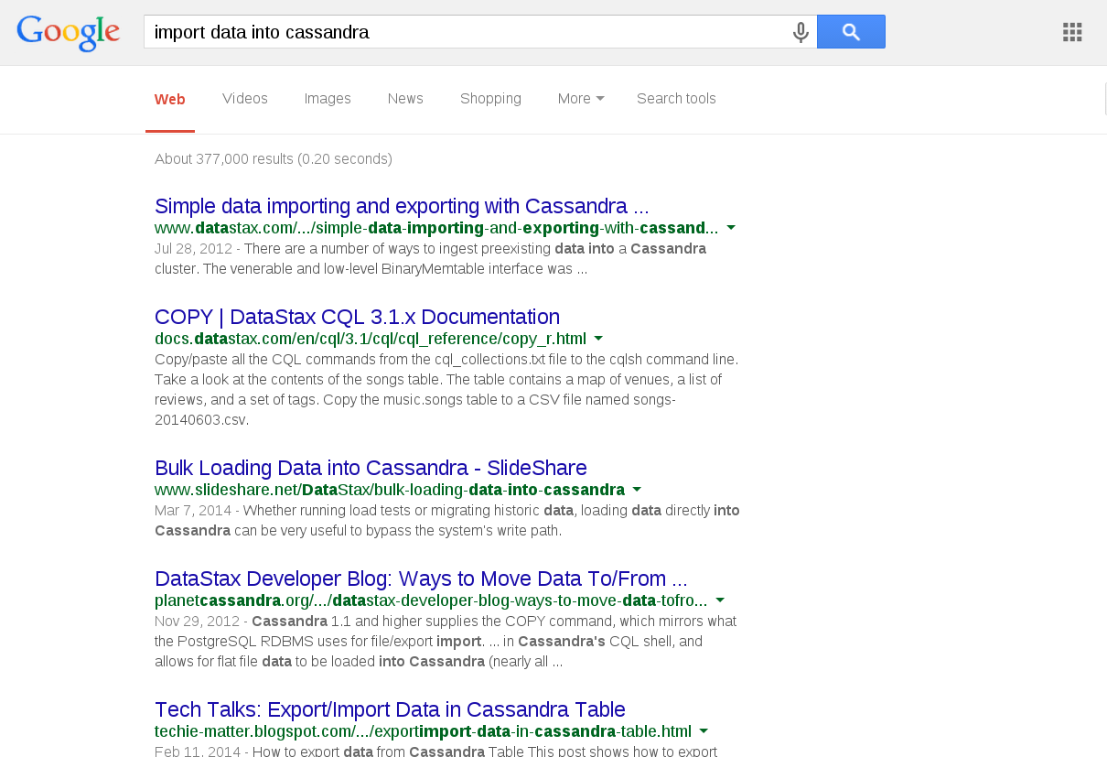
Import data into Cassandra
13
Notes:
GBE

Slide 36
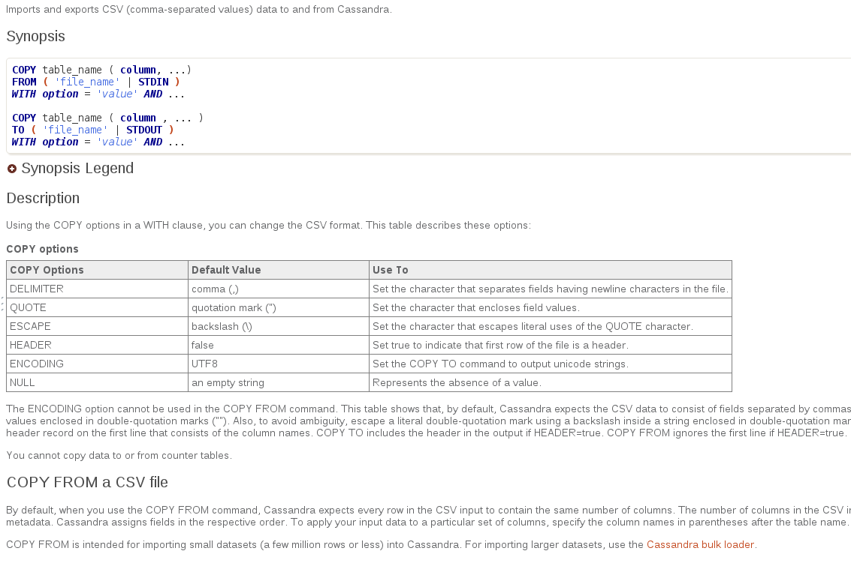
Import data into Cassandra: Copy
13
Notes:
GBE
COOL IT’S LIKE SQL, import CSV values
Read the fine prints: COPY FROM is intended for importing small datasets. For importing larger datasets, use the Cassandra bulk loader

Slide 37
Import data into Cassandra: Copy
Pre-processing:
project only the needed information
cleanup date format (ISO-8601 vs RFC3339)
14
sed 's/,/./g' | awk -F',' '{ printf "\"%s\",\"%s\",\"%s\"",$2,$1,$5;print ""}'
Pre-process
COPY
200 minutes*
100 hours*
100GB
2 billions rows
Notes:
AAR
les dates du fichier sont en format ISO-8601 mais Cassandra semble supporter uniquement une partie du ce standard RFC3339 dans lequel on doit avoir des . pour les fractions de seconde.
https://www.ietf.org/rfc/rfc3339.txt
L’etape de pre-processing: corriger le format des dates et garder que les colonnes utilisees par le COPY
200 hours (extrapolation apres le chargement d’1GB de donnees)

Slide 38
Import data into Cassandra: parallelize Copy
Naive parallelized COPY
launch one copy per node
launch multiple COPY threads / node
14
100GB
2 billions rows
pre-processing,
splitting
parallelized copy
Notes:
AAR

Slide 39
Import data into Cassandra: Copy
15
Notes:
AAR

Slide 40
How to speed up Cassandra import?
What really happens during the import?
IMPORT = WRITE
What really happens during a WRITE
16
Notes:
CHE

Slide 41
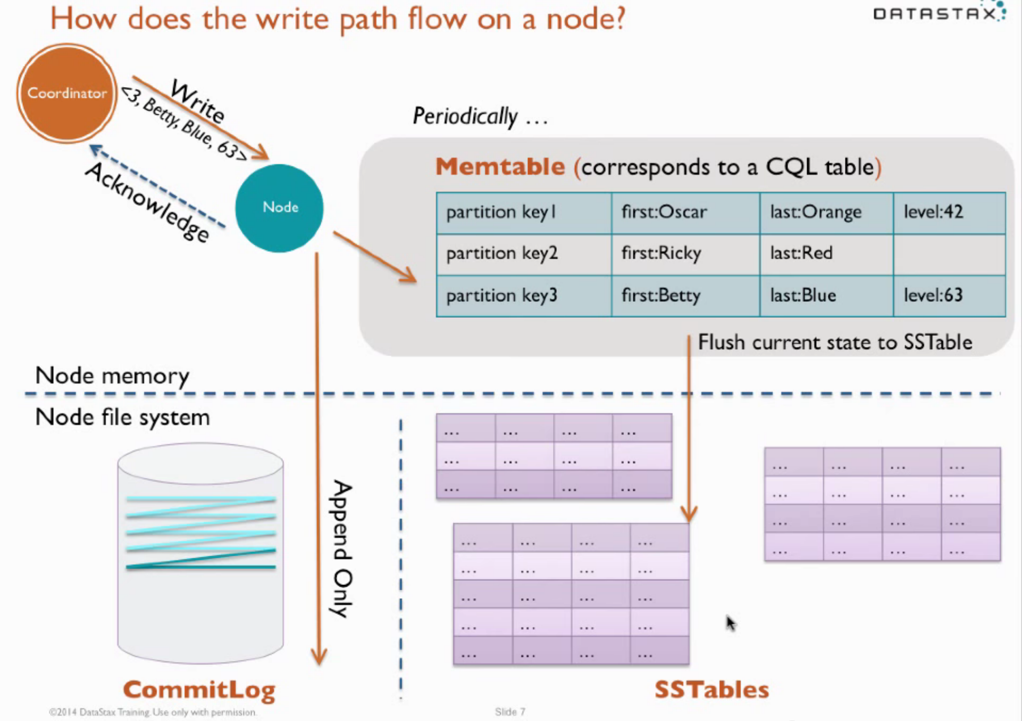
Cassandra Write Path Documentation
17
Notes:
CHE

Slide 42
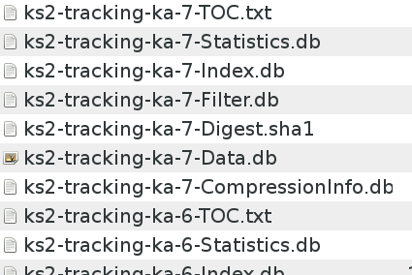
SSTableLoader
How to speed up Cassandra import => SSTableLoader
generate SSTables using the SSTableWriter API
stream the SSTables to your Cassandra cluster using sstableloader
17
SSTableWriter
sstableloader
300 hours*
2 hours*
100GB
2 billions rows
Notes:
CHE

Slide 43
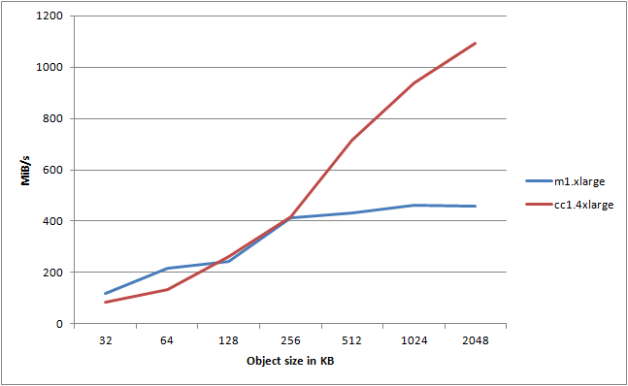
Import data into Cassandra from Amazon S3
S3 is distributed!
optimized for high-throughput when used in parallel
very high throughput to/from EC2
17
©2011 http://improve.dk/pushing-the-limits-of-amazon-s3-upload-performance/
Notes:
CHE

Slide 44

Import data into Cassandra from Amazon S3
S3 is a distributed file system
optimized for high-throughput when used in parallel
Use Spark as ETL
2 billions inserts
18
100GB
2 billions rows
S3
Notes:
AAR
Utiliser Spark comme un ETL, charger en parallel les donnees depuis S3
Persistez ces donnees dans le clusteur cassandra en utilisant le connecteur Datastax
Map! pas de reduce

Slide 45
Using Spark to parallelize the insert
use Spark to read/pre-process/write to Cassandra in parallel
map
2 billions inserts
18
100GB
2 billions rows
S3
Notes:
AAR
Spark does the
10h

Slide 46
Cheating / Modeling before inserting
instead of importing all the lines from the csv, use Spark to reduce the lines
map+reduce
2 billions inserts
18
100GB
2 billions rows
S3
Notes:
AAR
Ex:
inserer une seule ligne par plage horaire/cellule qui contient tous les nomero de telephones
1 ligne pour plage horaire/cell : 2400 de numero de telephone
reduire d’un ordre de magnitude le nombre des inserts
bigger rows but ready to be queried

Slide 47
Cheating / Modeling before inserting
instead of importing all the lines from the csv, use Spark to reduce the lines
map+reduce
1 million inserts
19
100GB
2 billions rows
S3
Notes:
AAR
1 ligne pour plage horaire/cell : 2400 de numero de telephone

Slide 48
Using AWS
Notes:
GBE

Slide 49
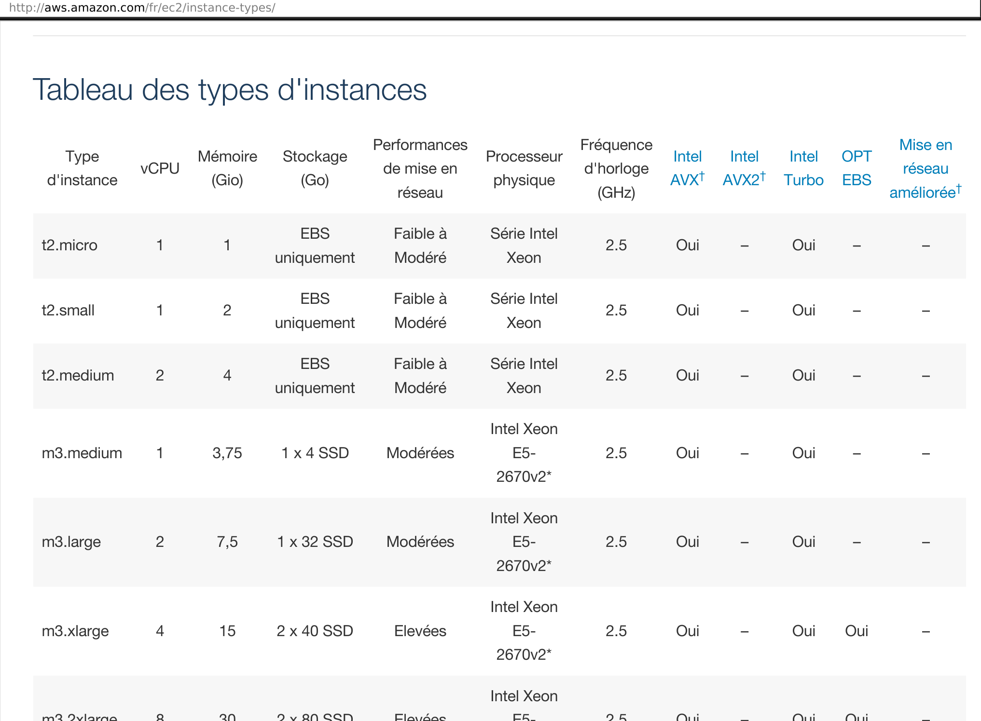
Choosing the right AWS Instance type
22
Notes:
GBE

Slide 50
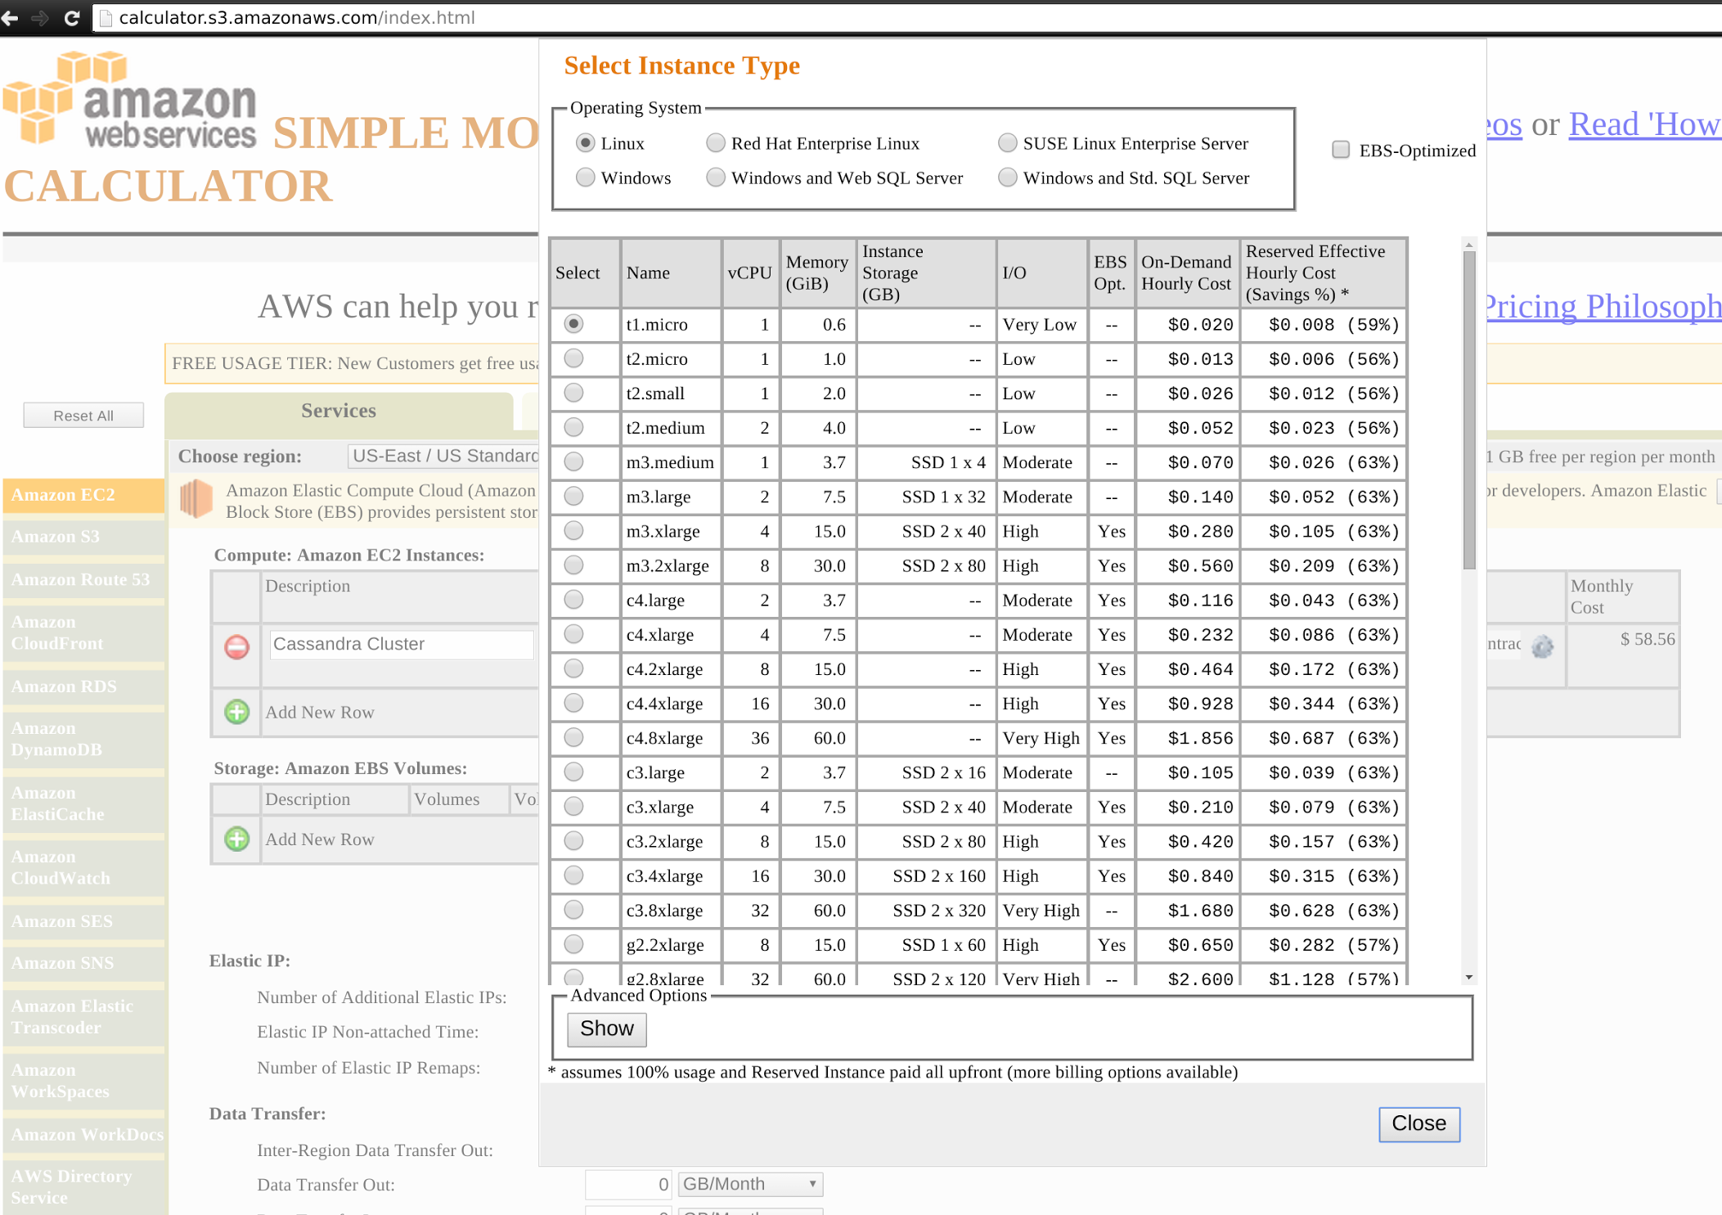
Shopping on Amazon
What can 300E get you: xHours of y Instance Types + Z EBS
22
Notes:
GBE

Slide 51
Capacity planning
Good starting point: 6 analytics nodes, M3.large or M3.xlarge, SSD
Finally : not so difficult to choose
23
Notes:
GBE
6 M3.large: X Ram, X total storage

Slide 52
Install from scratch
Avantages
install an open source stack
full control
latest version
Inconvenients
devops skills required
lot of configuration to do
version compatibility
time / budget consuming
NOT AN OPTION !
24
Notes:
GBE / CHE

Slide 53
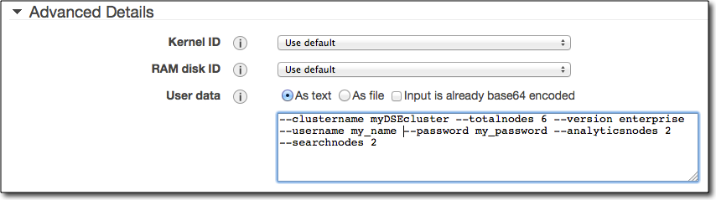
Start small
DataStax Enterprise AMI : 1 analytics node shared between Cassandra and Spark
25
Notes:
CHE
free to use !
easy monitoring via Opscenter
cluster analytics with Spark in one click
everything packaged and ready to run

Slide 54
Optimizing budget
Requirement:
Preload data
Goal:
Minimize cluster uptime
Strategies:
use EBS -> persistent storage (expensive, slow)
load the dataset on a node and turn off the others (free, time consuming)
do everything “the night before” (free, risky)
26
Notes:
AAR
Can you guess which strategy the students will choose ?
EBS not supported dans l’AMI Datastax?

Slide 55
Preparing for D-Day
Notes:
CHE

Slide 56
Preparing for the D Day
Preload the data into Cassandra on the AWS cluster
Input: earthquake date and location
Kill the closest node
Start simulation
monitor in realtime the alerting performance
Tuning (model, import)
Lather, rinse, repeat...
28
Notes:
CHE
TODO ADD VISUALISATION

Slide 57
How to stop a specific node of the cluster ?
Alternatives:
stop/kill the Cassandra process
turn off the gossip
AWS instance shutdown
The effect is the same
29
Notes:
CHE
Peu importe comment on le kill

Slide 58
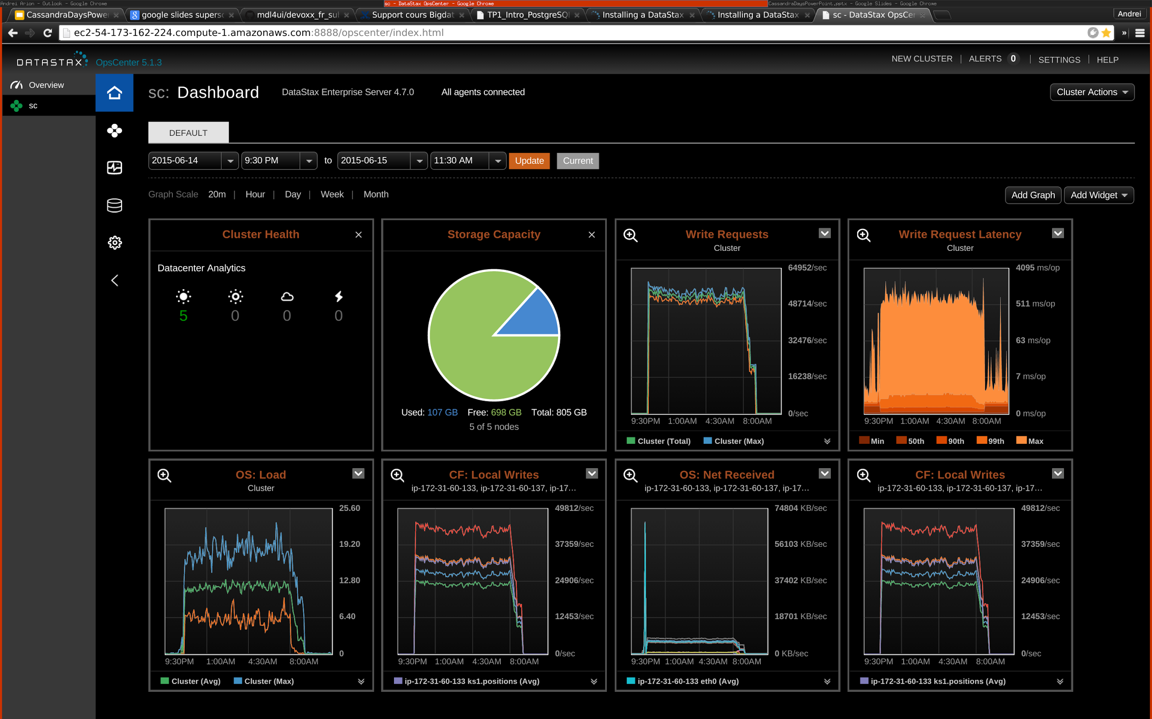
Pre-loading data
29
Notes:
CHE
Finalement le chargement via Spark c’est bien passe en un peu plus de 9h

Slide 59

Waiting our turn
30
Notes:
CHE

Slide 60
Conclusion
Notes:
GBE

Slide 61

Notes:
GBE

Slide 62
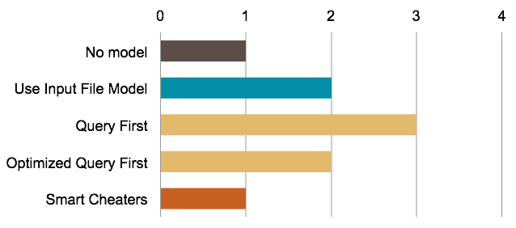
Data Model
Notes:
GBE

Slide 63
Modelling in SQL vs CQL
SQL => CQL : state of mind shifting
3NF vs denormalization
model first vs query first
SQL and CQL are syntactically very similar that can be confusing
no Joins, range queries on partition keys...
Notes:
AAR
CQL est tres proche du SQL au niveau de la syntaxe/rendu. Mais les reflex des bases relationnelles peuvent posser des problemes. 3FN, pas de jointures, pas de range query sur la cle de partition.

Slide 64
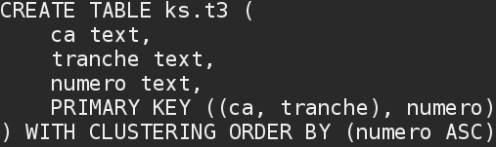
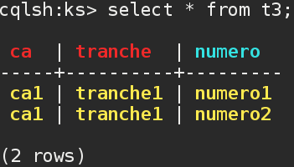
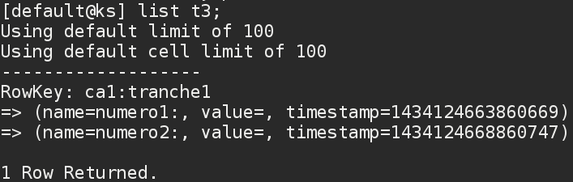
Modeling data: cqlsh vs cli
Notes:
AAR
De plus CQL essaye d’abstraire completement le stockage physique.
Ceci peut rendre difficile la comprehension du Cassandra

Slide 65
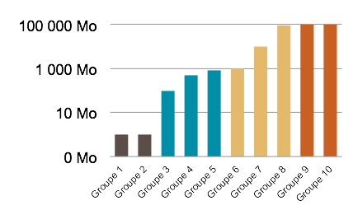
Importing Data
Notes:
CHE

Slide 66
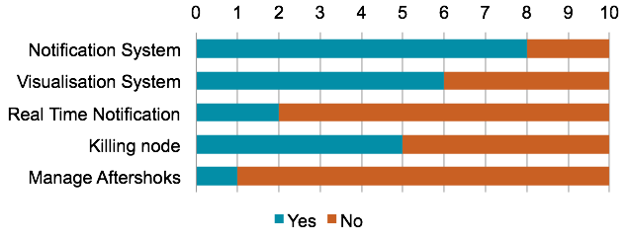
Development
Notes:
CHE

Slide 67
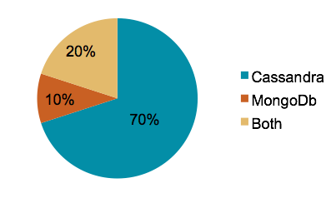
Architecture
Notes:
CHE

Slide 68
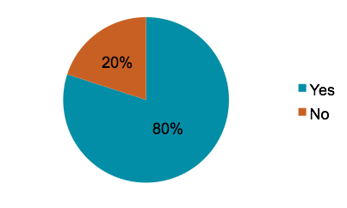
Amazon Web Services
Notes:
GBE

Slide 69
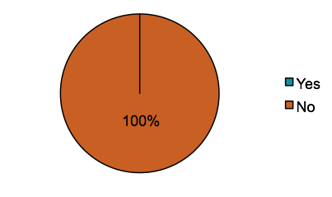
Quality
Notes:
GBE

Slide 70
What is the main problem ?
Modeling Data
Importing Data
Architecture
Development
Deployment
Quality
=> Multidisciplinary Approach
Notes:
GBE

Slide 71
Multidisciplinary approach
Team | 1 | 2 | 3 | 4 | 5 | 6 | 7 | 8 | 9 | 10
Modeling Data | √ | √ |  | √ |  | √ | √ | √ | √ | √
Importing Data |  |  |  |  |  |  |  | √ | √ | √
Architecture |  |  |  |  | √ | √ | √ | √ | √ | √
Development |  |  | √ |  | √ |  | √ | √ | √ | √
Deployment |  |  | √ | √ | √ | √ | √ | √ | √ | √
Quality |  |  | √ |  | √ | √ |  |  |  | √
Grade | 8 | 10 | 12 | 13 | 13 | 14 | 14.5 | 16 | 16.5 | 17
Notes:
GBE

Slide 72
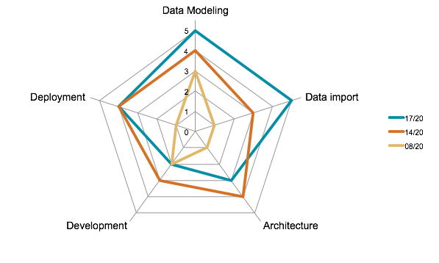
Team Skills Balance
Notes:
GBE

Slide 73
Conclusion
Easy to learn and easy to teach
Easy to deploy on AWS
Performance monitor for tuning the models
Passing from SQL vs CQL can be challenging
Fun to implement on a concrete use-case with time/budget constraints
Notes:
AAR

Slide 74

Thank you
Andrei Arion - aar@lesfurets.com
Geoffrey Bérard - gbe@lesfurets.com
Charles Herriau - che@lesfurets.com
@BeastieFurets
Notes:
AAR

